Slide 1
Comparison of outputs using the gene-agnostic nomenclature
with IgDiscover22
Bernat et al dataset
Analysed independently by Chris and by us (using same conditions)
Expect the same outputs

Slide 2
25 novel alleles identified by Chris
25 novel alleles identified by us

Slide 3
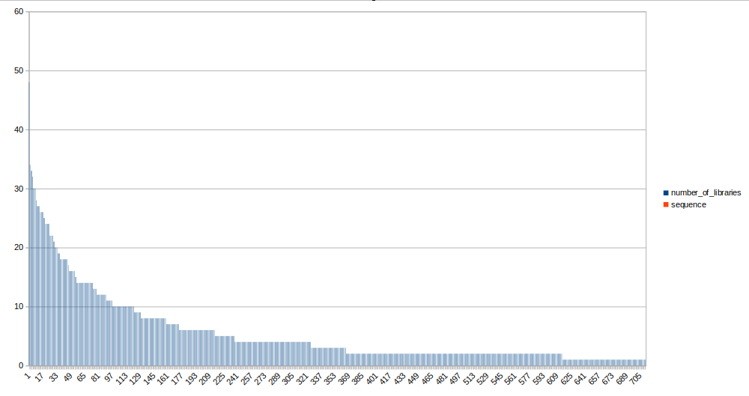
614 alleles in at least
2 independent libraries
710 alleles in total

Slide 4
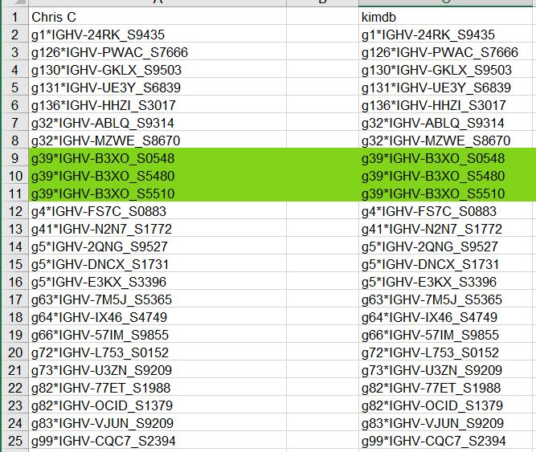
24 novel alleles

Slide 5
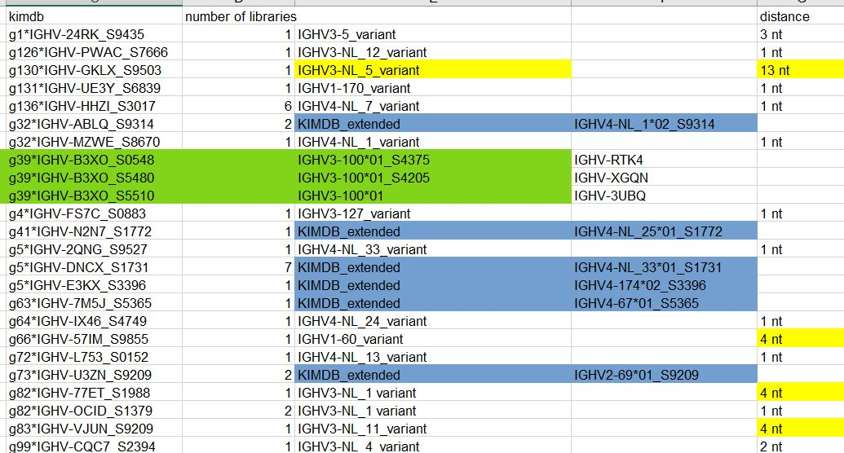

Slide 6
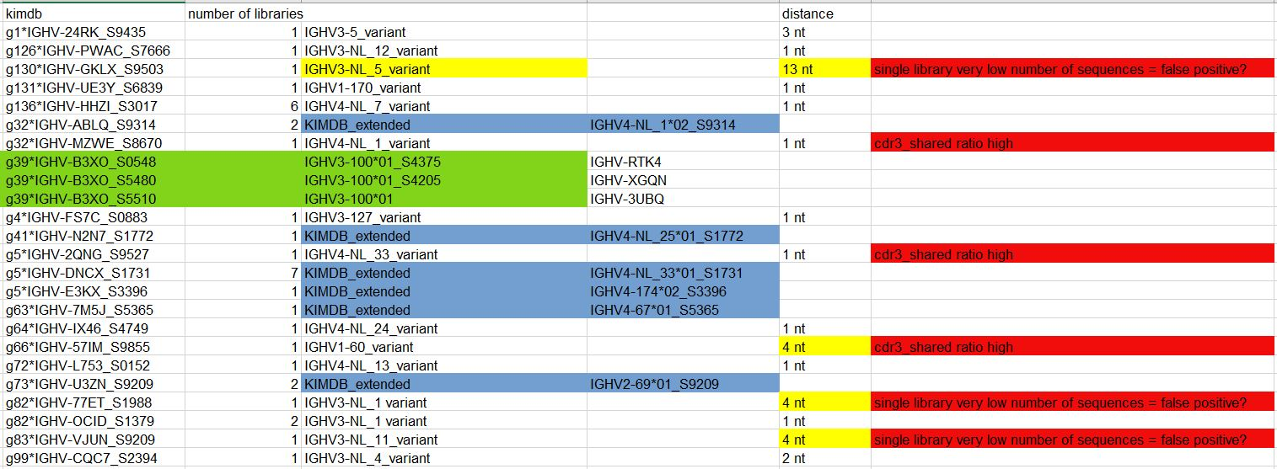

Slide 7
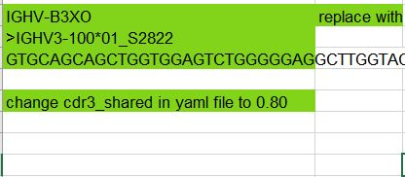
Alterations to analysis conditions

Slide 8
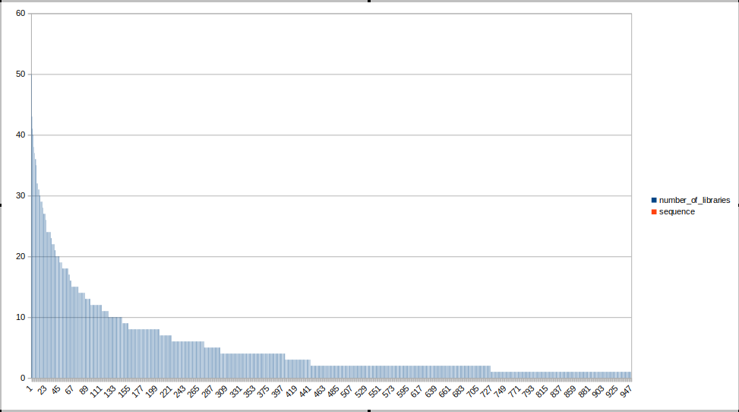
725 alleles in at least
2 independent libraries
947 alleles in total

